Slide 1
Deep Learning and NLP
Damir Cavar
April 2018

Slide 2
Agenda
NLP and language
Word embeddings
Deep Learning and NLP
Convolutional Networks
Recurrent Neural Networks
Seq2seq networks
Research projects at IU
Speech and Pragmatics/Semantics
Entity extraction and knowledge representations

Slide 3
NLP
What is NLP related to? Tendencies:
Natural Language Processing (more engineering oriented)
Computational Linguistics (more research and language oriented)
Levels, for example:
Processing speech and language at various levels
Speech, phonology, prosody, morphology, syntax, semantics, pragmatics…
Processing language data for applications
Document analysis, classification, information extraction, generation
Q&A, AI, IoT, Robotics
Machine Translation
Speech processing applications

Slide 4
NLP Technologies
Open Language Processing:
Stanford CoreNLP
SpaCy
OpenNLP
Natural Language Toolkit (NLTK)
Open Speech Processing:
Hidden Markov Toolkit (HTK)
KALDI
Commercial services:
Google APIs, Amazon, IBM Watson, etc.

Slide 5
NLP Demo
Stanford CoreNLP
NLP output as part of symbolic and statistical models in applications
Current situation:
NLP analyses are result of data driven machine learning methods, Neural Network or Deep Learning approaches
Issues:
Do we need NLP and what for?
Simple methods on words and strings are very powerful:
Bag of words and distributional properties

Slide 6
Language and Meaning
Compositionality
Meaning of a complex expression is determined by the meanings of the parts and their combinatorial principles, restrictions, or rules.
Distributional Semantics
Words in similar context tend to purport similar meaning.
Vector space for measuring and computing distributional properties of words.

Slide 7
Example
Download:
A text, e.g. The House of Pomegranates by Oscar Wilde.
Gutenberg Archive book 873
Direct link to UTF-8 text
Simple facts:
Number of tokens: 33570
Number of words: 4066
Mapping word frequency on word length...

Slide 8
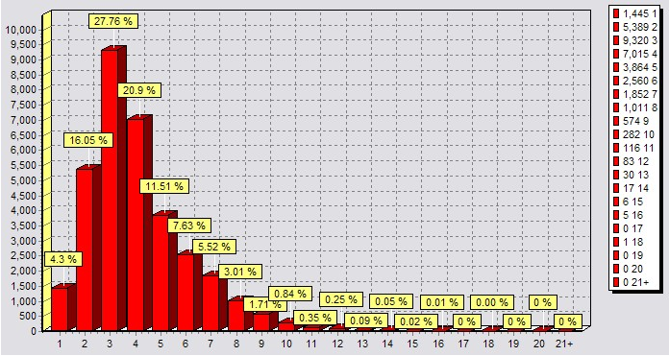
Frequency on Length

Slide 9
Quantitative Properties
49 most frequent words:
THE, AND, OF, TO, A, HE, HIS, IN, THAT, WITH,HIM, WAS, IT, I, HER, FOR, IS, ME, HAD, THEY,BUT, ON, AS, AT, SHE, NOT, FROM, THEIR, SAID,THOU, THEM, THEE, WHEN, WHO, WERE, SO,HAVE, LITTLE, OUT, YOUNG, MY, BY, BE, SOUL,THERE, CAME, THIS, WILL, INTO
together make up 16489 of 33570 tokens in the book/text
49% of all tokens
49 words out of 4066
1.2% of all words/types

Slide 10
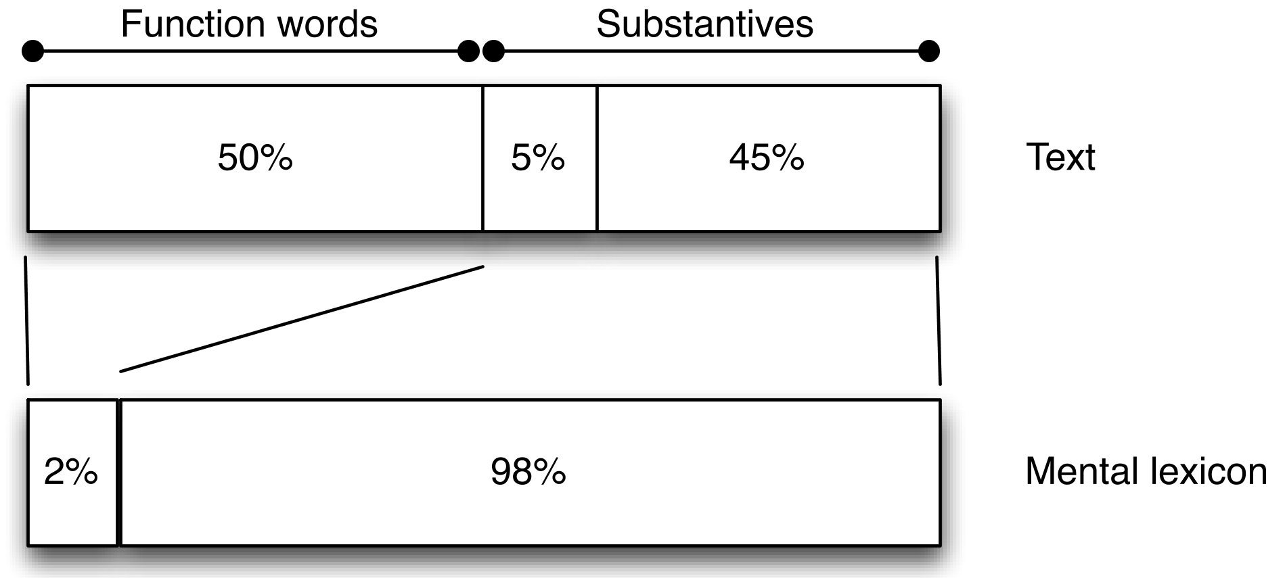
Mental Lexicon vs. Lexical Use

Slide 11
Quantitative Properties
Entropy effect on the lexicon
Language is highly dynamic and static/invariant at the same time
Open Class Lexicon:
Nouns, Verbs, Adjectives, ...
highly dynamic set in any language (one estimate on NYT: ca. 20,000 new words in English per year), leading to group, region, or dialect variation
Closed Class Lexicon:
Functional Categories (articles, prepositions, conjunctions)
static in any language (language specific) and over speakers (thus in text)

Slide 12
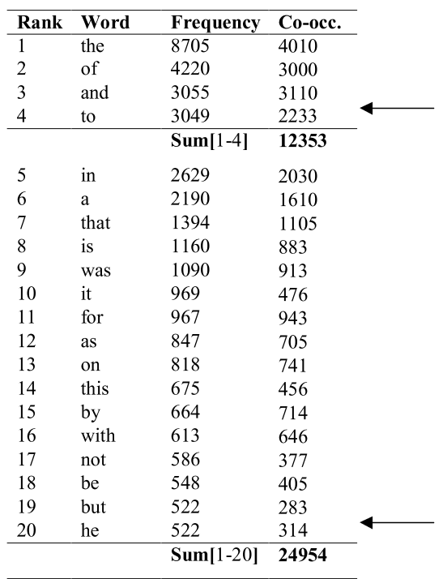
Distributional Properties

Slide 13
Distributional Properties
Vectorization of Distributional Properties
For every word:
Directional context vector of frequencies with N words from the set of words
Left and right context
Similarity Metric
Geometric distance (e.g. Cosine similarity, Euclidean Distance)
Results:
Words tend to cluster by category, semantic type, rough meaning

Slide 14
Word Meanings as Networks
Taxonomies of words (or concepts) (Thesaurus)
Word in its lemmatized base-form (nominative singular for nouns, infinitival form for verbs, etc.)
List of meanings and lexical type:
Examples of use: Example sentences
Description of meaning
List of relations to other words (or concepts)
Hypernyms (dominating type-of relation for words): bird is the hypernym of falcon, eagle, cardinal, crow; falcon isA bird
Hyponym (opposite of hypernym): crow is a hyponym of bird
Meronym (part-of relation): X is a meronym of Y, if Xs are parts of Y; feathers are meronyms of birds
Synonyms, etc.
Source:
Manual definition and specification

Slide 15
Word Meanings
Example taxonomy: WordNet (see NLTK)
Word meanings arranged in synsets
Examples from Manning (course material at Stanford University)
Synsets for good: Adept, expert, good, practiced, proficient, skillful, etc.
Problem: I am good at coding. Vs. I am an expert in coding.
Incomplete taxonomies (handcrafted):
Wicked, badass, nifty, crack, ace, wizard, genius, ninja, etc.
Subjective choice of elements in taxonomy
Maintenance labor intensive
Difficult computation of:
Word similarities
Dynamic properties of language difficult to capture

Slide 16
Discrete (Probabilistic) Representations
Similarity
Distributional vectors over frequency of context words
Can be complex and long over large vocabulary
Distance can be expressed in terms of symbolic networks even with probabilistic weights
Alternative
Semantic representation of a word encoded in a vector such that the similarity with another word can be computed directly
Note: the notion of semantic is quite stretched here!
All the context of a specific semantic value of a word mapped into a vector: a model in which a word predicts its context, or a context predicts words in it
Idea: If you can predict in which context a word appears, you understand the meaning of the word.

Slide 17
Semantics and Vectors
Pick a dense vector for a word such that it predicts other words in the context of that word well.
The context words will have a dense vector representation that allows them to be predicted as context words, or that allows one to compute the similarity to other words via a dot-product.
Word2Vec approach
Predict the probability of the context given the word: P(context|w_{t}) = …
Loss function tells us how well the prediction is done:
J = 1 – p(w_{-t}|w_{t})
-t here means the words that are not at position t in a text
Computing by optimization:
Compute the vectors for the words by minimizing the loss function

Slide 18
Word2Vec
Assume a window size of 2
Extracting training samples from source:
Source |  |  |  |  | Training samples
some | cats | love | some | dogs | (some, cats) (some, love)
some | cats | love | some | dogs | (cats, some) (cats, love) (cats, some)
some | cats | love | some | dogs | (love, some) (love, cats) (love, some) (love, dogs)
some | cats | love | some | dogs | (some, cats) (some, love) (some, dogs)
some | cats | love | some | dogs | (dogs, love) (dogs, some)

Slide 19
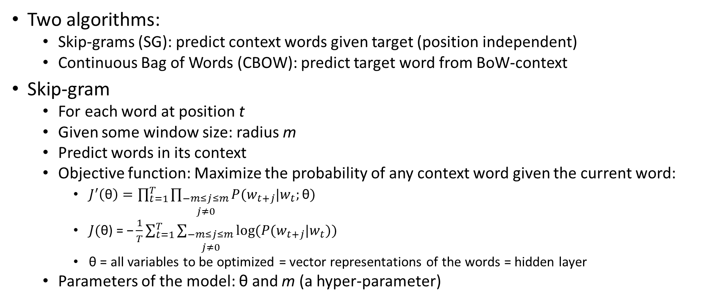
Word2Vec
Two algorithms:
Skip-grams (SG): predict context words given target (position independent)
Continuous Bag of Words (CBOW): predict target word from BoW-context
Skip-gram
For each word at position t
Given some window size: radius m
Predict words in its context
Objective function: Maximize the probability of any context word given the current word:
$J^{′}\left(\text{θ}\right)=\prod_{t=1}^{T}{\prod_{\begin{aligned}−m≤j≤m \\ j≠0\end{aligned}}{P(w_{t+j}|w_{t};\text{θ})}}$
$J(\text{θ}\text{) = −}\frac{1}{T}\sum_{t=1}^{T}{\sum_{\begin{aligned}−m≤j≤m \\ j≠0\end{aligned}}{log⁡(P(w_{t+j}|w_{t}))}}$
$\text{θ}$ = all variables to be optimized = vector representations of the words = hidden layer
Parameters of the model: $\text{θ}$ and m (a hyper-parameter)

Slide 20
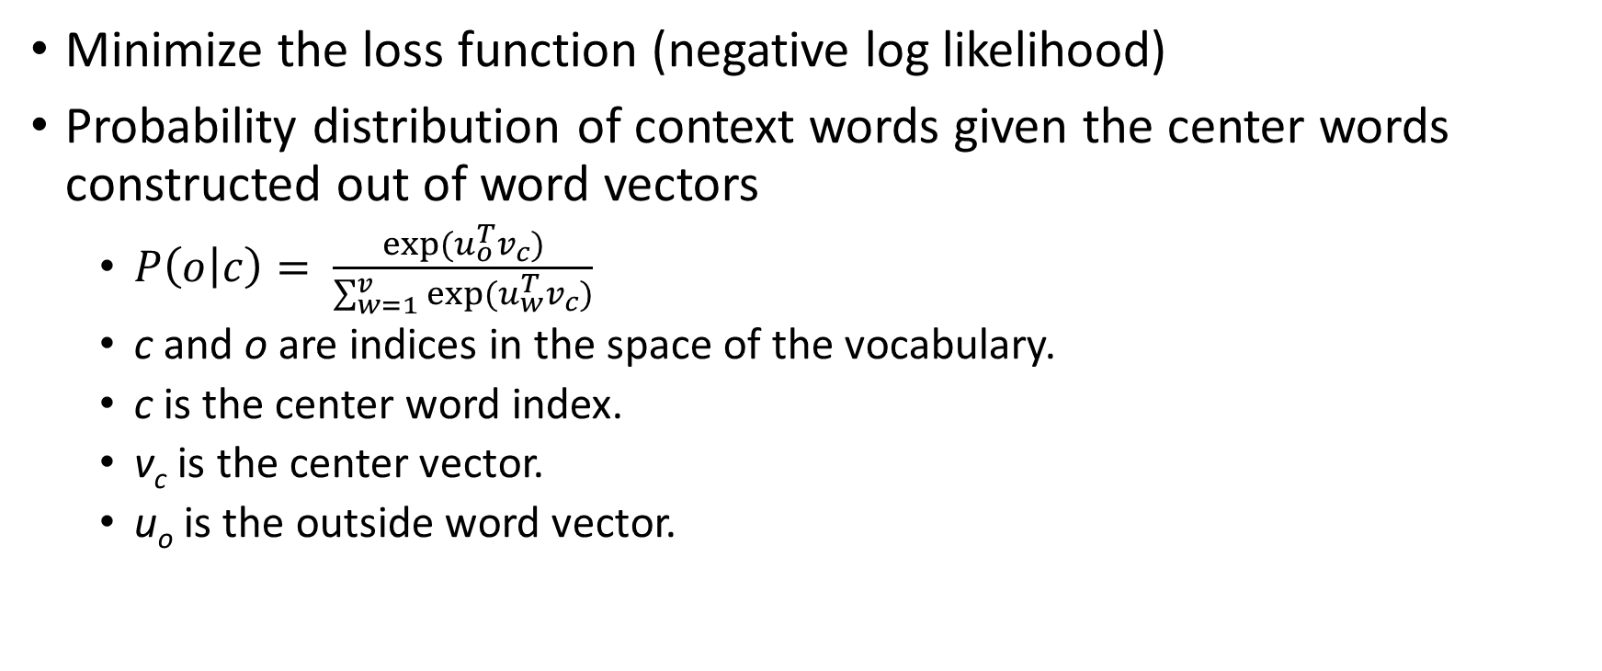
Word2Vec
Minimize the loss function (negative log likelihood)
Probability distribution of context words given the center words constructed out of word vectors
$P\left(o | c\right)= \frac{exp⁡(u_{o}^{T}v_{c})}{\sum_{w=1}^{v}{exp⁡(u_{w}^{T}v_{c})}}$
c and o are indices in the space of the vocabulary.
c is the center word index.
v_{c} is the center vector.
u_{o} is the outside word vector.

Slide 21
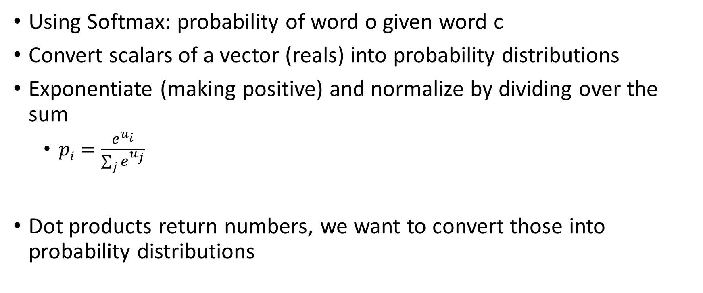
Word2Vec
Using Softmax: probability of word o given word c
Convert scalars of a vector (reals) into probability distributions
Exponentiate (making positive) and normalize by dividing over the sum
$pi=\frac{e^{u_{i}}}{\sum_{j}{e^{u_{j}}}}$
Dot products return numbers, we want to convert those into probability distributions

Slide 22
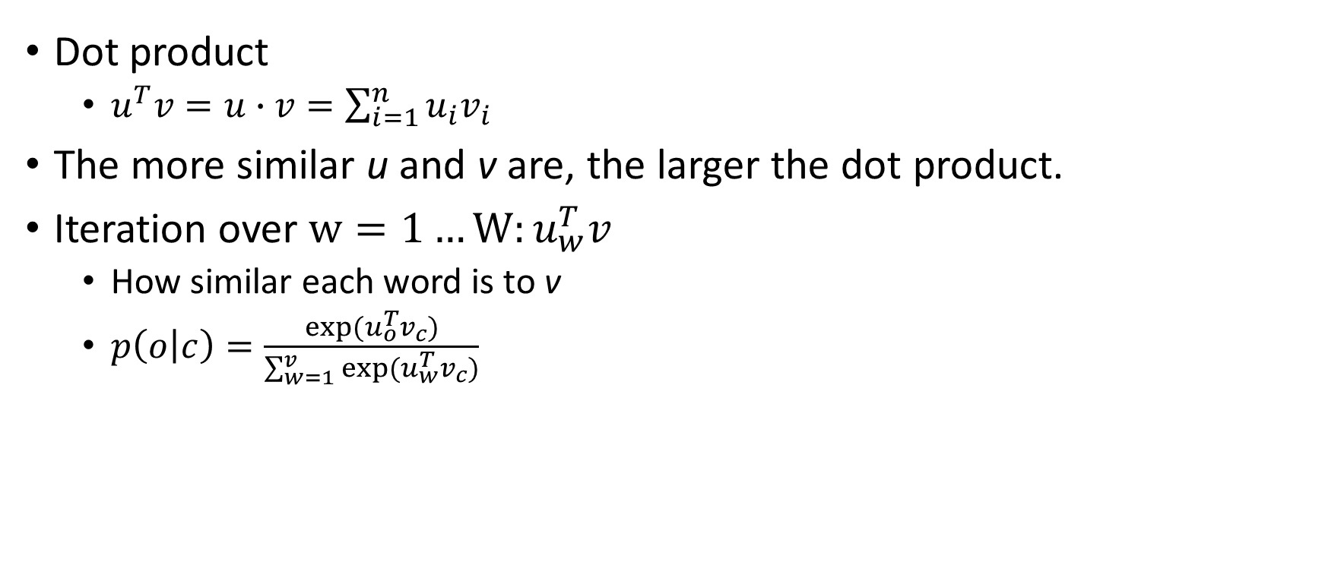
Semantic and Vector Similarity
Dot product
$u^{T}v=u∙v=\sum_{i=1}^{n}{u_{i}v_{i}}$
The more similar u and v are, the larger the dot product.
Iteration over $w=1…W:u_{w}^{T}v$
How similar each word is to v
$p\left(o | c\right)=\frac{exp⁡(u_{o}^{T}v_{c})}{\sum_{w=1}^{v}{exp⁡(u_{w}^{T}v_{c})}}$

Slide 23
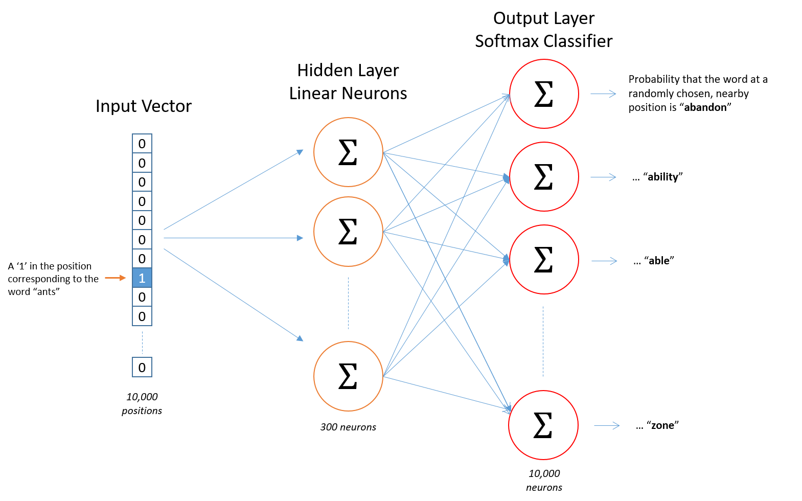
Word2Vec
See Chris McCormick

Slide 24
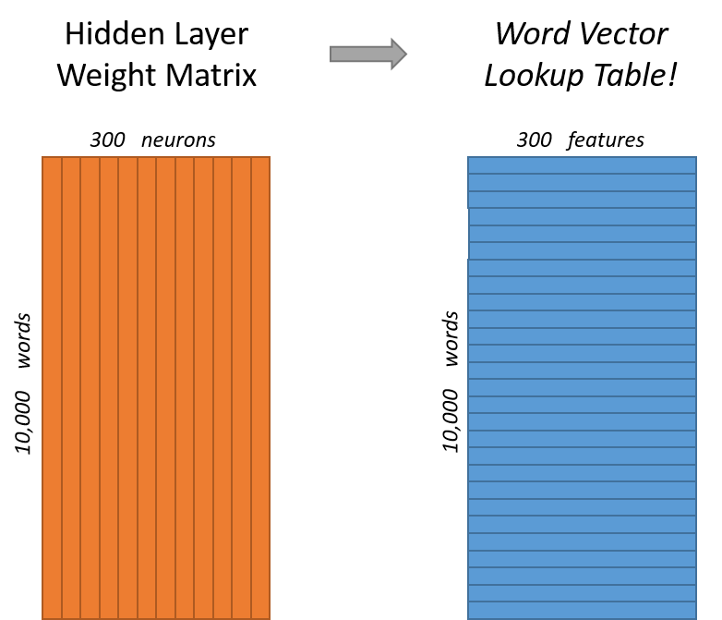
Word2Vec
See Chris McCormick
Learn:
Hidden Layer Weight Matrix
These represent the word vectors
Output layer:
Use softmax to generate a probability distribution.
Ignored in the end.

Slide 25
Word2Vec
Intuition
Similar words have similar contexts.
The network has to predict similar context words for two similar words.
If we have a model that predicts the context of words, the word vectors have to be similar for two similar words.
Effect:
Similar words will have similar contexts, thus similar vectors.
Linguistically related and similar words should have similar vectors as well:
Cat and Cats

Slide 26
Word2Vec
Oversimplifications:
Bag of Word concept
Relative position of words is ignored, but:
St. George killed the dragon. ≠ The dragon killed St. George.
Metaphorical interpretation, idioms, fixed expressions:
The dragon kicked the bucket.
It is raining cats and dogs.
Implicatures and presuppositions
Invisible categories and relations:
I want to read the book.
I want John to read the book.
Long distance relations:
Peter told me yesterday that Mary claimed that Sue bought a car.
What did Peter tell you yesterday that Mary claimed that Sue bought?
It works good enough in many cases!

Slide 27
Word Embeddings
Word2Vec word vectors
Core input to many DL NLP applications or models
Example:
Sentence classification in sentiment analysis
Input: sequence of N vectors, for every word in a sentence its word vector
PoS-tagging
Named Entity Recognition
Machine Translation
Image Labeling

Slide 28
Sequence Processing
Natural Language Input has variable length (text)
Possibility: truncation, padding, etc.
Alternative approaches
Convolutional Neural Networks (CNNs)
Recurrent Neural Networks (RNNs)
Example: CNNs for image processing

Slide 29
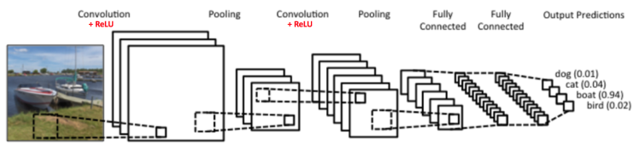
LeNet Architecture
LeCun et al. (1998)

Slide 30
Tutorial Sources
Sources:
CS231n Convolutional Neural Networks for Visual Recognition (Stanford)
https://cs231n.github.io/convolutional-networks/
Ujjwal Karn: An Intuitive Explanation of Convolutional Neural Networks
https://ujjwalkarn.me/2016/08/11/intuitive-explanation-convnets/
Adam Geitgey: Machine Learning is Fun! Part 3: Deep Learning and Convolutional Neural Networks
https://medium.com/@ageitgey/machine-learning-is-fun-part-3-deep-learning-and-convolutional-neural-networks-f40359318721

Slide 31
Main Operations
Four main operations in the CNN:
Convolution
Non Linearity (Rectified Linear Unity, ReLU)
Pooling or Sub Sampling
Classification (Fully Connected Layer)

Slide 32

Example
Image representations
Matrix of pixel values (see here)
Terms
Channel
refers to a certain component of an image
standard digital camera image: 3 channels = red, green and blue
3 x 2d-matrices stacked over each other, one for each color
pixel values in the range 0 to 255
Grayscale image: 1 channel
Here: grayscale images, 1x 2d matrix
Value of each pixel: 0 to 255, 0 = black, 255 = white

Slide 33
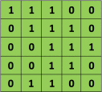
Convolution
Primary purpose:
Extract features from the input image
Preserving spatial relationship between pixels by learning image features using small squares of input data
Focus on the process:
Image as a matrix of pixel values
Example: 5 x 5 image, pixel values are 0 and 1

Slide 34
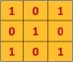

Convolution
Assume an additional matrix 3 x 3:
Convolution of 5 x 5 image and 3 x 3 matrix computed as a shift by a pixel over column and row:

Slide 35
Convolution
Computation:
Slide the orange matrix over original image (green) by 1 pixel (= ‘stride’)
For every position compute element wise multiplication between the two matrices and sum up the multiplication outputs to get a score in the output matrix (pink)
3 x 3 matrix “sees” only a part of the input image in each stride

Slide 36
Convolution
The 3×3 matrix: filter, kernel, feature detector
Matrix formed by sliding the filter over the image and computing the dot product: Convolved Feature, Activation Map, Feature Map
Filters act as feature detectors, features extracted from the original input image
Different values of the filter matrix produce different Feature Maps for the same input image

Slide 37

Convolution
Example:
Input Image:
effects of convolution with different filters on next slide
Operations:
Edge Detection
Sharpen
Blur
by changing numeric values in the filter matrix

Slide 38


Slide 39

Example 2:

Slide 40
CNNs
Previous example:
filter (red outline) slides over the input image (convolution operation) producing a feature map
Convolution of another filter (green outline) over the same input image produces a different feature map
Convolution operation captures the local dependencies in the original image
Different filters generate different feature maps from the same original image
Input image and the filters are simply numeric matrices

Slide 41
CNNs
CNNs learn the values of filters during the training process
Hyper-parameters:
number of filters
filter size
architecture of the network
More filters correlates with more image features and improves the recognition of patterns in unseen images
Size of Feature Maps (Convolved Feature) determined by:
Depth
Stride
Zero-padding

Slide 42
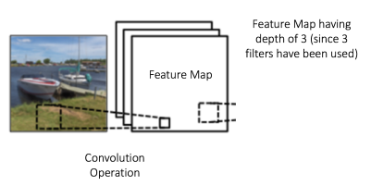
Depth
number of filters used for the convolution operation
In the boat example:
convolution of original boat image using 3 distinct filters
producing 3 different feature maps
Feature maps: stacked 2d matrices
Depth of the feature map is 3

Slide 43
Stride
Number of pixels by which to slide filter matrix over input matrix
With stride = 1: filters are moved one pixel at a time
With stride = 2: filters jump to 2nd pixel with every slide
Larger strides result in smaller feature maps

Slide 44
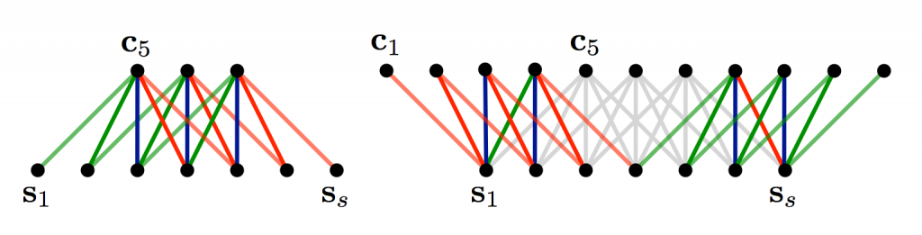
Zero-padding
Effect: it allows us to control the size of the feature map
Adding zero-padding: wide convolution
Not using zero-padding: narrow convolution
3 x 3 filter in center of matrix is fine, but the edges get ignored
To apply filter to first element of matrix use zero-padding

Slide 45
Zero-padding
Narrow convolution: (7 - 5) + 1 = 3
Wide convolution: (7 + 2*4 - 5) + 1 = 11
General computation of output size:
$n_{out}=\left(n_{in }+2∗n_{padding}−n_{filter}\right)+1$

Slide 46
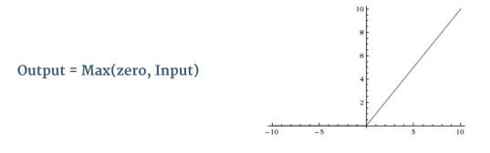
Non-linearity
Rectified Linear Unit (ReLU) used after every Convolution operation
Element wise operation (applied per pixel)
Replaces all negative pixel values in feature map by zero
Purpose: introduce non-linearity in CNN
Convolution is linear: element wise matrix multiplication and addition
ReLU accounts for non-linearity

Slide 47

Non-linearity
ReLU applied to one of the feature maps:
output feature map: ‘Rectified’ feature map

Slide 48
Pooling
Spatial Pooling: subsampling or down-sampling
reduces the dimensionality of each feature map
retains the most important information
Different types:
Max
Average
Sum
etc.

Slide 49
Pooling
Define window:
Spatial neighborhood (e.g. a 2×2 window) from the rectified feature map
Max Pooling:
Take the largest element from the window.
Average Pooling:
Take the average of all elements from the window.
Sum Pooling:
Take the sum of all elements in the window.
In practice: Max Pooling is preferred and performs better

Slide 50
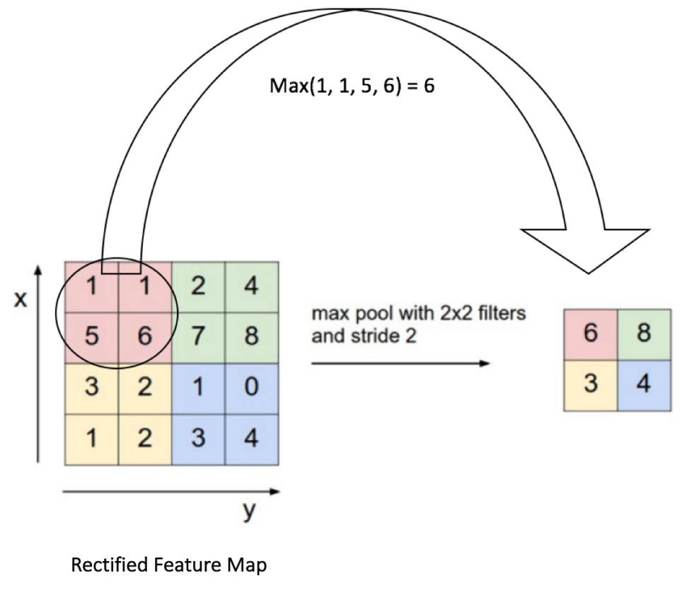
Pooling
Example of Max Pooling on a Rectified Feature map (result of convolution + ReLU) using a 2 x 2 window:

Slide 51
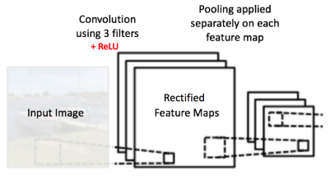
Pooling
Example:
slide a 2 x 2 window by 2 cells (= stride)
take max. value in each region
reducing the dimensionality of feature map
In the CNN example:
Pooling is applied separately to each feature map
3 pooled output maps from 3 input maps

Slide 52
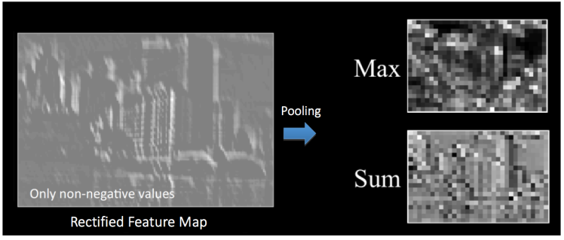
Pooling Effect

Slide 53
Pooling
progressively reduce the spatial size of the input representation
makes the input representations (feature dimension) smaller and more manageable
reduces the number of parameters and computations in the network, controlling overfitting
makes the network invariant to small transformations, distortions and translations in the input image
small distortion in input will not change the output of Pooling, since maximum/average value in a local neighborhood is used
Result in almost scale invariant representation of input image ( “equivariant”)
Detection of objects in an image independent of their location

Slide 54
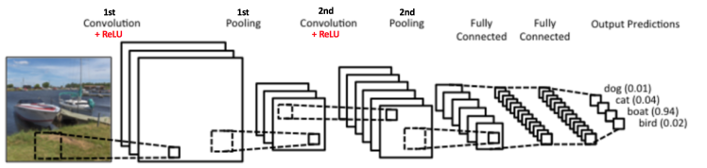
Architecture

Slide 55
Convolution Steps
Two sets of Convolution, ReLU and Pooling layers
2nd Convolution layer performs convolution on the output of the first Pooling Layer using 6 filters to produce 6 feature maps
ReLU is then applied individually on all of these 6 feature maps
Max Pooling operation separately on each of the six rectified feature maps
Output of 2nd Pooling Layer:
Input to Fully Connected Layer

Slide 56
Fully Connected Layer
Traditional Multi Layer Perceptron
Softmax activation function in the output layer
classifiers like SVM can be used
“Fully Connected”
every neuron in the previous layer is connected to every neuron on the next layer
Output from convolutional and pooling layers:
high-level features of input image
Purpose of Fully Connected layer:
use these features for classifying the input image into various classes based on the training dataset
Example: image on 4 possible outputs

Slide 57
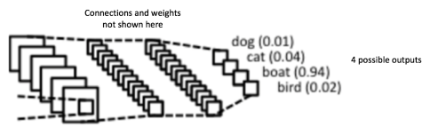
Fully Connected Layer

Slide 58
Fully Connected Layer
Learning classification weights
Learning non-linear combinations of convolutional features
Most features from convolutional and pooling layers may be good for classification task
Combinations of these features might be better
Softmax on output layer:
Sum of output probabilities is 1

Slide 59
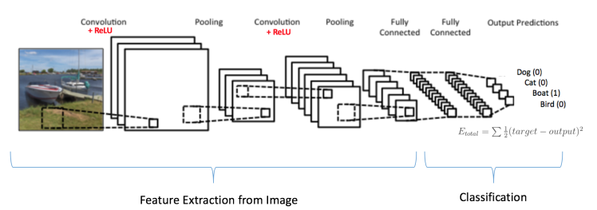
Training
Convolution + Pooling layers: Feature Extractors from input
Fully Connected layer: classifier over extracted features
Example:
Input Image = Boat
Target Vector = [0, 0, 1, 0]

Slide 60
Training
Overall process:
Define parameters: number of filters, filter sizes, architecture of the network etc.
do not change during training process
only values of the filter matrix and connection weights are updated
Step 1: initialization of filters and parameters = weights with random values
Step 2: training image as input, forward propagation step (convolution, ReLU and pooling operations, forward propagation in the Fully Connected layer), to find the output probabilities for each class
Example: output probabilities for boat image: [ 0.2, 0.4, 0.1, 0.3 ]
Weights are randomly assigned for the first training example, output probabilities are also random
Step 3: Compute total error at the output layer (summation over all 4 classes)
$error=\sum{\frac{{\left(target probability −ouput probability\right)}^{2}}{2}}$

Slide 61
Training
Step 4: Backpropagation to calculate the gradients of the error with respect to all weights in the network;
use gradient descent to update all filter values / weights and parameter values to minimize the output error
Weights are adjusted in proportion to their contribution to the total error.
With the same image input again: output probabilities might be [ 0.1, 0.1, 0.7, 0.1 ], which is closer to the target vector [ 0, 0, 1, 0 ]
The NN has learnt to classify this particular image correctly by adjusting its weights / filters such that the output error is reduced
Step 5: Repeat steps 2-4 with all training images

Slide 62
CNNs and Language / Text

Slide 63
CNNs for NLP
CNNs based on pixel convolution
Instead of image pixels:
input is sentences or documents represented as a matrix
each row of the matrix corresponds to one token
a word
a character
Here: each row is a vector representing a word in an input sentence
Typical vector representation for each word:
Word embeddings (low-dimensional representations) like word2vec or GloVe
Potentially feature vector (vectorized properties)
Possible: one-hot vectors that index the word into a vocabulary

Slide 64
CNNs for NLP
Example:
for a 10 word sentence using a 100-dimensional embedding
a 10×100 matrix as input (the “image”)
In vision:
filters slide over local patches of an image
In NLP:
filters slide over full rows of the matrix (words)

Slide 65
CNNs for NLP
Filter matrix:
Width of filters: usually the same as the width of the input matrix
Height (region size) variable
typical sliding windows over 2-5 words at a time

Slide 66
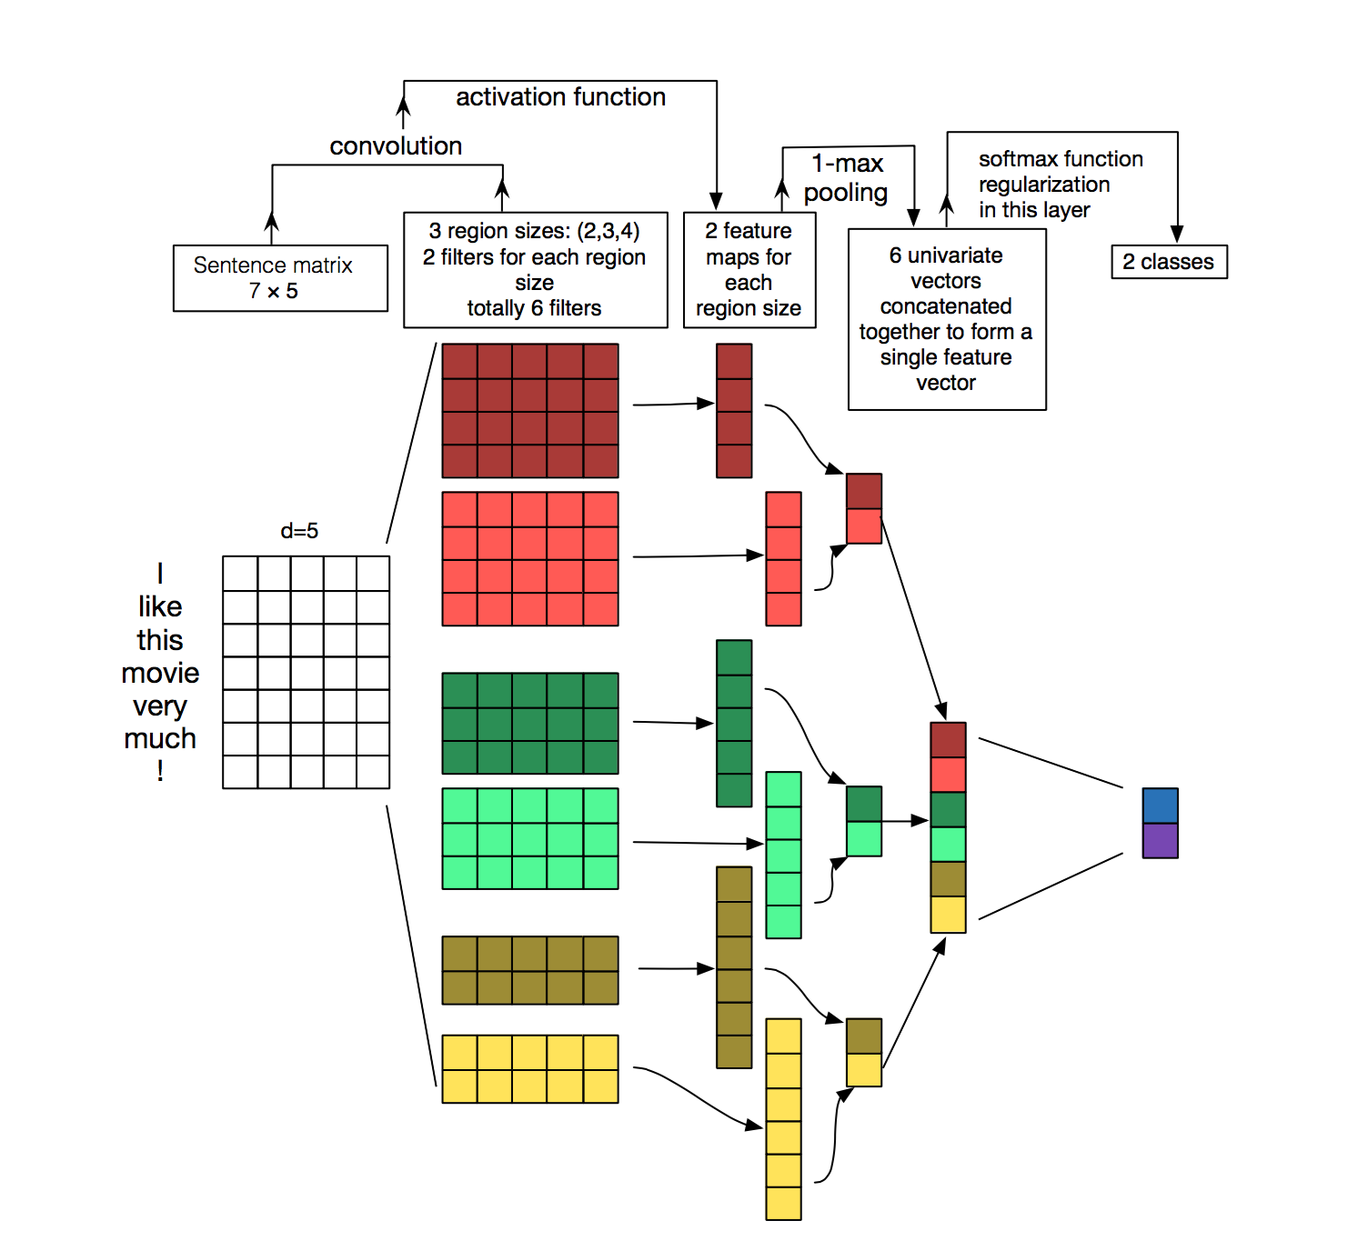
CNNs for NLP
Zhang, Y., & Wallace, B. (2015) A Sensitivity Analysis of (and Practitioners’ Guide to) Convolutional Neural Networks for Sentence Classification.

Slide 67
CNNs for NLP
Architecture for sentence classification
Three filter region sizes: 2, 3 and 4, each of which has 2 filters.
Every filter performs convolution on the sentence matrix and generates (variable-length) feature maps.
1-max pooling is performed over each map, i.e., the largest number from each feature map is recorded.
A univariate feature vector is generated from all six maps.
These 6 features are concatenated to form a feature vector for the penultimate layer.
The final softmax layer then receives this feature vector as input and uses it to classify the sentence.
Assumption: binary classification, thus two possible output states.

Slide 68
CNNs for NLP
Image vs. NLP:
Intuitions for Computer Vision make sense:
Location Invariance
Local Compositionality
In NLP:
Position of words in a sentence matters:
Subject usually precedes the predicate in English.
Object usually follows in verb in English.
Images:
Pixels close to each other are likely to be semantically related (part of the same object).
In NLP: adjacent words are not necessarily related:
What did John claim to own?

Slide 69
CNNs for NLP
Image vs. NLP:
Free “word order” languages: phrases can be broken up by other words
Discontinuities in Croatian or Polish:
Ivan se penje [ na veliko stablo ]
I. self climbs on big tree
[ na veliko stablo ] se Ivan penje.
[ na veliko ] se Ivan [ stablo ] penje

Slide 70
CNNs for NLP
Compositionality:
“Clearly, words compose in some ways, like an adjective modifying a noun, but how exactly this works what higher level representations actually ‘mean’ isn’t as obvious as in the Computer Vision case.”
This argument is weak:
We have a good understanding of how compositionality works in language, at the syntactic level as well as at higher semantic levels.

Slide 71
CNNs for NLP
Maybe CNNs are not a good fit for NLP?
Better fit might be Recurrent Neural Networks (RNNs)
RNNs resemble sequential left to right processing of language (incremental processing)
CNNs do work, though.

Slide 72
CNNs for NLP
CNNs applied to some NLP problems perform well.
“All models are wrong, but some are useful.”
Example:
Bag-of-words model
Multiset approach: words and frequencies, represented as vector
Disregarding grammar or word order
Makes wrong assumptions (e.g. no relation between words assumption)
Oversimplification
Applied to numerous problems performs very well.

Slide 73
CNNs for NLP
Pro CNNs:
CNNs are very fast.
Convolutions are central for computer graphics.
Implemented on hardware level: GPUs.
Efficient representation:
N-gram models lead to large “vocabulary” with increasing N.
Common models not more than 3-grams.
Google’s models not larger than 5-grams.
Convolutional filters can learn good representations with filters larger than 5 in width.
One could think of learned filters to capture properties that include or are similar to N-grams, but in a more compact way.

Slide 74
CNNs for NLP
Hyperparameters
Narrow or Wide Convolution
Zero-padding
Stride Size

Slide 75
Narrow and Wide Convolution
Effect: it allows us to control the size of the feature map
Adding zero-padding: wide convolution
Not using zero-padding: narrow convolution
3 x 3 filter in center of matrix is fine, but the edges get ignored
To apply filter to first element of matrix use zero-padding
Source: A Convolutional Neural Network for Modelling Sentences (2014)

Slide 76
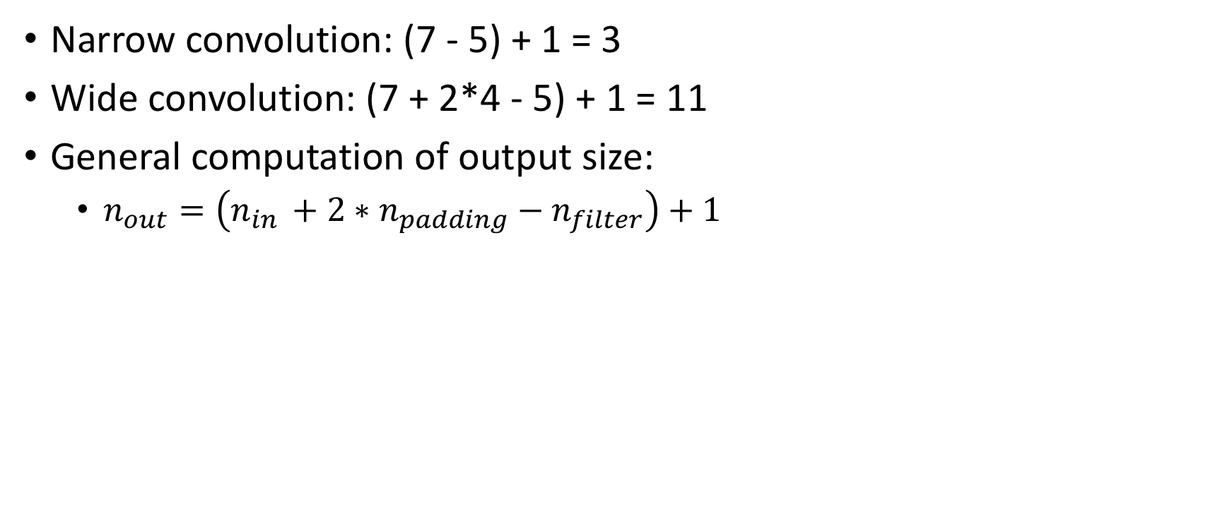
Zero-padding
Narrow convolution: (7 - 5) + 1 = 3
Wide convolution: (7 + 2*4 - 5) + 1 = 11
General computation of output size:
$n_{out}=\left(n_{in }+2∗n_{padding}−n_{filter}\right)+1$

Slide 77
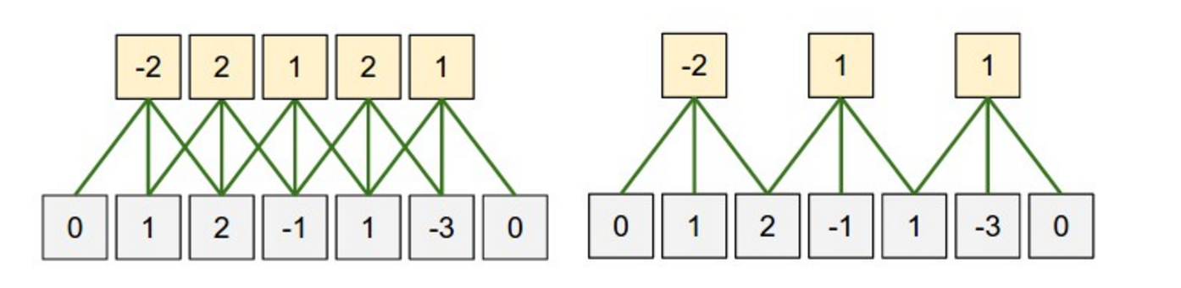
Stride
Stride Size
Number of pixels/cells by which to slide filter matrix over input matrix
With stride = 1: filters are moved one cell at a time
With stride = 2: filters jump to 2nd cell with every slide
Larger strides result in smaller feature maps
Source: http://cs231n.github.io/convolutional-networks/

Slide 78
Pooling Layer
Spatial Pooling: subsampling or down-sampling
reduces the dimensionality of each feature map
retains the most important information
Different types:
Max
Average
Sum
etc.

Slide 79
Pooling Layer
A key aspect of CNNs: pooling layers
applied after the convolutional layers
Pooling layers subsample their input
most common way: apply a max operation to the result of each filter
not necessarily pool over complete matrix:
pool over a window
In NLP:
typically pooling over the complete output, yielding just a single number for each filter

Slide 80
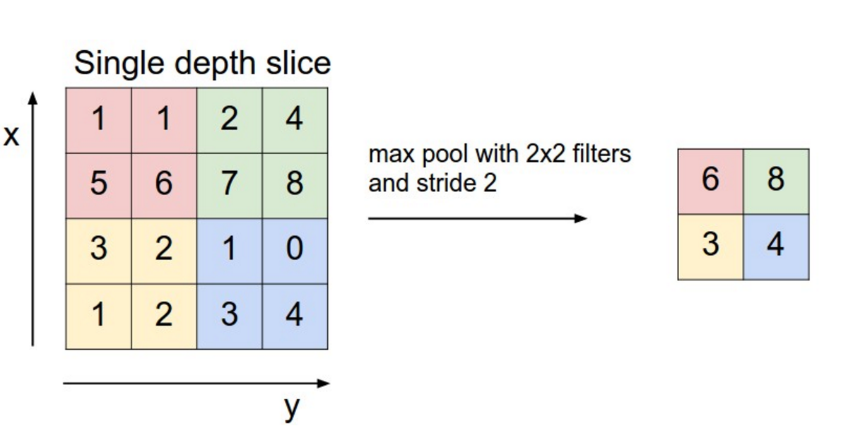
Pooling Layer
Source: http://cs231n.github.io/convolutional-networks/#pool

Slide 81
Pooling Layer
Why pooling?
pooling provides a fixed size output matrix
required for classification
Example:
if 1,000 filters, and max pooling applied to each
Result: a 1000-dimensional output, regardless of size of filters, or size of input
With this we can classify with:
variable size sentences
variable size filters
always same output dimensions to feed into a classifier

Slide 82
Pooling Layer
Pooling reduces the output dimensionality but (hopefully) keeps the most salient information
each filter is detecting a specific feature
e.g. detecting if the sentence contains a negation like “not amazing” for example
If this phrase occurs somewhere in the sentence:
result of applying the filter to that region will yield a large value, but a small value in other regions
By performing the max operation:
keeping information about whether or not the feature appeared in the sentence, but losing information about where exactly it appeared

Slide 83
Pooling Layer
Locality Information:
is useful
Pooling effect:
similar to a bag of words or n-grams model
losing global information about locality (where in a sentence something happens)
keeping local information captured by filters
“not amazing” is very different from “amazing not”
imagine recognition:
pooling provides basic invariance to translating (shifting) and rotation
pooling over a region:
the output will stay approximately the same even if you shift/rotate the image by a few pixels, because the max operations will pick out the same value regardless

Slide 84
Channels
Channels are different “views” of your input data
Example:
in image recognition: typical channels are RGB (red, green, blue)
Possibility:
apply convolutions across channels, either with different or equal weights.
In NLP various channels as well:
a separate channels for different word embeddings (word2vec and GloVe for example), or
a channel for the same sentence represented in different languages, or phrased in different ways

Slide 85
CNNs for NLP
Applications of CNNs to Natural Language Processing
Most natural fit for CNNs in NLP
classifications tasks
Sentiment Analysis
Spam Detection
Topic Categorization
Sequence Tagging is problematic:
Convolutions and pooling operations lose information about the local order of words
PoS Tagging or Named Entity Extraction is more problematic in a pure CNN architecture, but not impossible:
add positional features to the input

Slide 86
CNNs for NLP
Kim, Y. (2014). Convolutional Neural Networks for Sentence Classification. Proceedings of the 2014 Conference on Empirical Methods in Natural Language Processing (EMNLP 2014), 1746–1751.
Evaluates a CNN architecture on various classification datasets:
Sentiment Analysis
Topic Categorization
Achieves very good performance across datasets, and new state-of-the-art on a few.
Simple network:
The input layer is a sentence comprised of concatenated word2vec word embeddings.
Convolutional layer with multiple filters
A max-pooling layer
A softmax classifier.
Experiments with two different channels in the form of static and dynamic word embeddings:
one channel is adjusted during training and the other isn’t

Slide 87
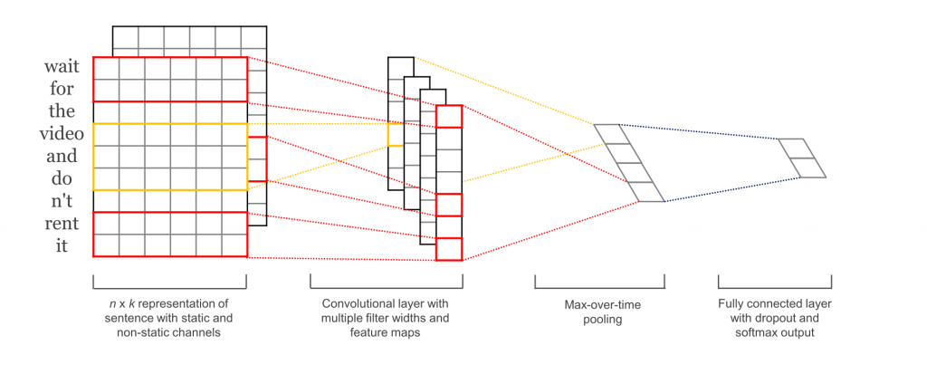
CNNs for NLP
Kim (2014)

Slide 88
CNNs for NLP
Wang, P., Xu, J., Xu, B., Liu, C., Zhang, H., Wang, F., & Hao, H. (2015). Semantic Clustering and Convolutional Neural Network for Short Text Categorization. Proceedings ACL 2015, 352–357.
Similar to architecture in Kim (2014):
Added an additional layer that performs: “semantic clustering”

Slide 89
CNNs for NLP
Johnson, R., & Zhang, T. (2015). Effective Use of Word Order for Text Categorization with Convolutional Neural Networks. To Appear: NAACL-2015, (2011).
Trains a CNN from scratch
no need for for pre-trained word vectors like word2vec or GloVe
Applies convolutions directly to one-hot vectors
Proposes a space-efficient bag-of-words-like representation for input data
reduces the number of parameters the network needs to learn

Slide 90
CNNs for NLP
Johnson, R., & Zhang, T. (2015). Semi-supervised Convolutional Neural Networks for Text Categorization via Region Embedding.
Extending previous model:
additional unsupervised “region embedding” that is learned using a CNN predicting the context of text regions
work well for long-form texts (e.g. movie reviews)
unclear performance on short texts (e.g. tweets)
Pre-trained word embeddings
Should yield larger gains for short texts
Not so much for long texts

Slide 91
CNNs for NLP
Zhang, Y., & Wallace, B. (2015). A Sensitivity Analysis of (and Practitioners’ Guide to) Convolutional Neural Networks for Sentence Classification.
Empirical evaluation on the effect of varying hyper-parameters in CNN architectures
Many hyper-parameters to choose from:
Input representations (word2vec, GloVe, one-hot)
number and sizes of convolution filters
pooling strategies (max, average)
activation functions (ReLU, tanh)

Slide 92
CNNs for NLP
Zhang & Wallace (2015)
investigating hyper-parameter impact on performance and variance over multiple runs
For implementation of own CNN for text classification:
Zhang & Wallace (2015) is a starting point
Results:
max-pooling always beats average pooling
ideal filter sizes are important but task-dependent
regularization doesn’t seem to make a big different in specific NLP tasks
Caveat of this paper:
all datasets were similar in terms of their document length
same guidelines may not apply to data that looks considerably different

Slide 93
CNNs for NLP
Nguyen, T. H., & Grishman, R. (2015). Relation Extraction: Perspective from Convolutional Neural Networks. Workshop on Vector Modeling for NLP, 39–48.
CNNs for Relation Extraction and Relation Classification tasks
Input to the convolutional layer:
word vectors
relative positions of words to the entities of interest
Assumption:
positions of the entities are given, and that each example input contains one relation

Slide 94
Relations
Information extraction
IE = extracting information from text
Sometimes called text analytics commercially
Extract entities
People, organizations, locations, times, dates, prices, ...
Or sometimes: genes, proteins, diseases, medicines, ...
Extract the relations between entities
Located in, employed by, part of, married to, ...
Figure out the larger events that are taking place

Slide 95
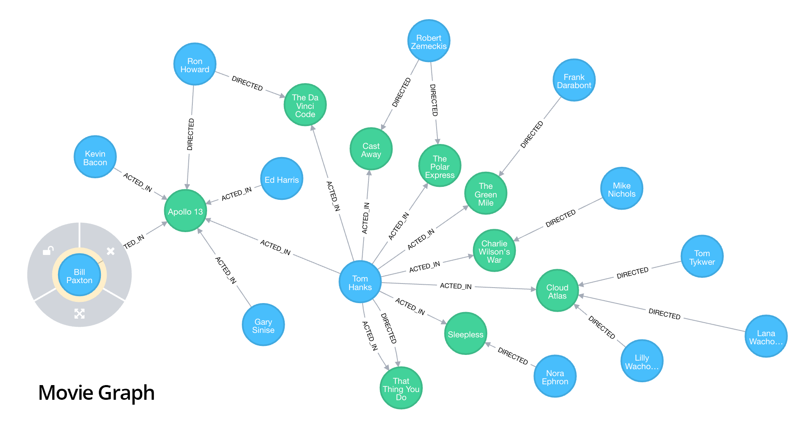

Slide 96
Graph as Knowledge Representation
Knowledge levels
World knowledge
More persistent and less dynamic
Dialog knowledge
Temporal and local
Highly dynamic
Individual knowledge
Somewhat persistent
Dynamic
Domain specific knowledge
Legal, medical, business, …

Slide 97
Linguistic Resources
Taxonomy or Ontology lookup
Hyper- and hyponym relations
Word Sense Disambiguation
Ambiguity estimates
Resources
WordNet (NLTK)
Multilingual implementations of WordNet
Thesauri
…

Slide 98
Knowledge Graphs
Numerous knowledge graphs
Former: Freebase
Google Knowledge Graph
Yago
DBpedia
Wikipedia backup
…
Ontologies
Protégé and archive

Slide 99
NLP Pipelines
Varying levels of linguistic analysis
Tokenization (CoreNLP, spaCy, NLTK)
Lemmatization (CoreNLP, NLTK)
Part-of-Speech Tagging (CoreNLP, spaCy, NLTK)
Named Entity Recognition (CoreNLP, spaCy)
Ontology/Taxonomy/Thesaurus (hyper-, hypo-, meronym etc.) (NLTK)
Constituent Parsing (CoreNLP, NLTK without grammars)
Dependency Parsing (CoreNLP, spaCy)
Coreference Analysis (CoreNLP)

Slide 100
NLP Pipelines
Missing levels of analysis and annotation:
Semantic features (limited in NER and PoS-tags) and Pragmatic level analysis
Definiteness or specificity is missing
Clause detection
Clause-type detection
Scope relation annotation or analysis (except encoded in bracketed tree annotation in the CoreNLP output)
Tempus (in particular periphrastic)
Mood (Realis or Irrealis)
Voice
Scope of operators, particles, negation
…

Slide 101
Examples
Peter likes to swim in the lake.
I want John to read this book.
John bought a car and Peter drives it.
John bought a car and drives it.
John read a book and Mary a newspaper.
John bought and Peter crashed the car.
Tim Cook is the CEO of Apple and a board member of Google Inc.
The mass expulsion of Russian personnel stationed in the United States was the largest ever, eclipsing even the darkest days of the global showdown with the Soviet Union.

Slide 102
Requirements
Fact extraction:
Core semantic relations (CRS) in clauses:
Subject – Verb/Predicate – Object
Subject – Predicate
Subject – Verb - (Core Semantic Relations)
Extended Semantic Relations
Modification (properties of arguments)
Restrictions (semantic, e.g. relative clauses)

Slide 103
Extraction of CRS
Types of CRS
Copula constructions
Transitive predicates
Intransitive predicates
Complementing predicates
Dependent clause types
Declarative vs. interrogative clausal domains
Control constructions
Gapping
CRS Directionality
Passive reverts the relations

Slide 104
Implicatures and Presuppositions
Linguistic derivations:
John bought a car. Vs. John bought the blue car.
Most likely Implicatures:
Definiteness: speaker and hearer are familiar with the cars in general, the one car in particular.
Specificity: there was at least one more car and none of the other cars is blue.
John fed his cat.
-> John owns a cat.
Domain specific:
John tweets: “The price of Apidra went up by 100%”
Ontological knowledge (cTAKES & UMLS): Apidra is a common drug, an insulin, to treat diabetes.
-> John (or a closed family member) most likely suffer from some form of diabetes.

Slide 105
Graph Mapping
Conversion of extracted concepts, relations to
Core concepts and relations
Implied and presupposed ones
Unifying concepts:
Coreference analysis and anaphora resolution
Mapping of concept to unique referent: the CEO of Apple = Tim Cook = he = Timothy Donald Cook (Wikipedia ID)
Expansion using OWL and WordNet:
Timothy Donald Cook = human, etc.

Slide 106
Triple Stores
Traditional databases store structured data in tables, possibly with relations to other tables
Alternative:
Storage for concepts and their relations to other concepts
Concept – Predicate – Concept relations
Tim Cook is the CEO of Apple = Tim_Cook isA CEO + Tim_Cook worksFor Apple + Apple employs Tim_Cook
Existing XML standards for the encoding and exchange of such triples: Resource Description Framework (RDF)

Slide 107
Graph Database
Tim Cook
More generic than Triple Stores
Basic elements:
Concepts with possible attributes:
Concept: Tim Cook
Label: CEO
Attribute: age = 57
Attribute: residence = Palo Alto
…
Relations between concepts with possible attribute:
Relation: livesIn
Attribute: from = May 2003
Attribute: to = October 2013
…
livesIn
Palo Alto

Slide 108
Knowledge Graph
Graph DB with facts or knowledge about concepts and their relations
Extensions:
Ontologies
Web Ontology Language (OWL) as Description Logic representations
Taxonomies of classes of concepts (hyper- and hyponymy relations)
Relations with e.g. Domain and Range specifications
Concepts like CEO isA Human isA Thing…
Assertions of facts, instances, relations
Individuals: Tim Cook as instance of CEO

Slide 109
Knowledge Graph
Vectorization:
Concept label or class
N most dominant concepts and predicates
(Convolutional approach: reduction to features in regions)
Learning classes or labels for new concepts:
Classification task using vectorized sub-graph as input and class ID as output
Learning new classes:
Clustering approach?

Slide 110
Multi-Modality
Language
Speech
Prosody
Focus
Visual input
Generic properties of concepts, events
World knowledge
Universe of discourse

Slide 111
Prosody and Stress
Focal stress and intonation contour
Generating initial corpus sets
Measuring:
Intensity
Root-Mean-Square (RMS) energy over frames
Mel-Frequency Cepstral Coefficients
(Log) Filterbank Energies
Spectral Subband Centroids
…

Slide 112
Prosody and Stress
Speech API with timing of strings (e.g. Google API)
Focus in English via e.g. Root-Mean-Square (RMS) energy over frames
Libraries:
Python_speech_features
Librosa (Python)
OpenSMILE (C++) (realtime stream processing)
…
Alignment of word or phrase:
Contrastive focus: JOHN bought a new car. John bought a NEW CAR.
Verum focus: John DID buy a new car. John BOUGHT a new car. (contrastive)
NN classifiers:
Interrogative and declarative sentence types
Sentiment and emotional status

Slide 113
Vision
Processing images or video
Object recognition
Object properties (e.g. relative size, color)
Storing:
World Knowledge
Dialog Memory
Easy to use technologies:
OpenCV, etc.

Slide 114
Next steps
Next Topics:
Recurrent Neural Networks and Language Models
Gated Feedback Recurrent NNs, Long Short-Term Memory for Machine Translation
Presentation agenda:
?
Assignments:
Grades for 2 this week
Assignment 3 today/tomorrow
Assignment 4 in 1.5 weeks
Project meetings! (Makeup session)

Slide 115
Tutorial
Sources:
CS231n Convolutional Neural Networks for Visual Recognition (Stanford)
https://cs231n.github.io/convolutional-networks/
Ujjwal Karn: An Intuitive Explanation of Convolutional Neural Networks
https://ujjwalkarn.me/2016/08/11/intuitive-explanation-convnets/
Adam Geitgey: Machine Learning is Fun! Part 3: Deep Learning and Convolutional Neural Networks
https://medium.com/@ageitgey/machine-learning-is-fun-part-3-deep-learning-and-convolutional-neural-networks-f40359318721
Denny Britz: Understanding Convolutional Neural Networks for NLP
http://www.wildml.com/2015/11/understanding-convolutional-neural-networks-for-nlp/

